Slide 1


Online Book Store
Under Guidance of:
Pooja Mehta
Submitted By:
1. Nausheen Shaikh
2. Divya Raulo
3. Sayali Patil
4. Siddhesh Amle
5. Atharva Gawle
6. Prachi Marothiya

Slide 2
INTRODUCTION
The online bookstore is a form of e-commerce and book sales industry.
Online book system allows users to buy books conveniently, easy to find the books, cost saving. So need of online bookstore in today's world of development is extreme.
Online bookstore is the main function of this site, customer can connect to the Internet through the computer into the online bookstore and then check the book information, if you need to purchase you should register, select their own books and place an order.
With the online bookstore system, customer do not need to blindly go to various places to find their own books in this pandemic period, but only a computer connected to the Internet, in the search box, type you want to find of the book information retrieval, you can efficiently know whether the site has its own books, which you can direct purchase, if not available, you can provide advice to the admin. This greatly facilitates every consumer, saving time and labor.
This site is made for the students to purchase the books as they are facing lots of problem during this period of pandemic.
The Administrator will have additional functionalities when compared to the common user. They can add, delete and update the book details, book categories, member information and also confirm a placed order

Slide 3
PROJECT OBJECTIVE
The main objective of the project on online book store is to manage the details of Books, Books Category, Customers, Orders, Confirm Orders.
It manages all the information about Book item, Payment, Confirm order.
The project is totally built at administrative end and thus only the admin has the right to give access to users based on authentication.
It tracks all the details about the customer, order, confirm order.

Slide 4
TECHNOLOGIES USED
MySQL
Spring Boot
Angular
Postman

Slide 5
PROPOSED SYSTEM
This system is based on the web application that aims to serve the books which is requested by user.
We can see that nearly everything is very much possible to perform within a single click , so this will help you to computerize the system of online bookstore management, so that readers can access the system online and search the books that they want.
A user visiting the website can see a wide range of books arranged in respective categories .
The user may select desired book and view its price.

Slide 6
REQUIRED SPECIFICATIONS
Hardware Configuration | Software Configuration
Operating System : Windows 10 and above | Software IDE: Eclipse, Postman, MySQL, VS Code.
Hard Disk: 500 GB | Language: JAVA, Type Script, HTML, CSS
RAM: 8 GB | Front End: Angular, Boot Strap
 | Back End: Spring Boot, MySQL.

Slide 7
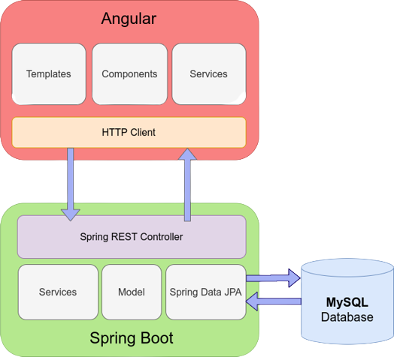
CONNECTION TO DATABASE FRONT END TO BACK END

Slide 8
MODULES
The system contains 5 Modules
ADMIN - Registration and Login.
CUSTOMER- Signup and Login.
BOOK LIST - Add/Edit Book items by Admin.
CART - Customer can add food from menu list
ORDER - It shows items which present in cart and order status.
PAYMENT – Customer has to pay for completion of order.

Slide 9
SPRING ANNOTATIONS
@Controller :The @Controller annotation indicates that a particular class serves the role of a controller. Spring Controller annotation is typically used in combination with annotated handler methods based on the @RequestMapping annotation.
@Autowired: The @Autowired annotation provides more fine-grained control over where and how autowiring should be accomplished.
@RequestMapping : The @RequestMapping is one of the most common annotation used in Spring Web applications. This annotation maps HTTP requests to handler methods of MVC and REST controllers.
@Entity: The @Entity annotation specifies that the class is an entity and is mapped to a database table.

Slide 10
SPRING ANNOTATIONS
@Table: The @Table annotation is used to create a table in database.
@JoinColumn: The @JoinColumn is used to specify a column for joining an entity association or element collection.
@PutMapping : The @PutMapping is used for update the records.
@PostMapping: The @PostMapping is used to create a resource Mapping.
@GetMapping: The @GetMapping is used to read all the inserted records.
@DeleteMapping : The @DeleteMapping is used to delete the records.
@PathVariable: The @Path Variable annotation is used to extract the value from the URL.
@RequestParam: The @RequestParam annotation is used to read the form data and bind it automatically to the parameter present in the provided method.

Slide 11
SPRING ANNOTATIONS
@Request Body: The @RequestBody annotation is applicable to handler methods of spring controller. spring should deserialize a request body into an object.
@OneToOne Mapping: The @OneToOne JPA annotation is used to map the source entity with the target entity, Hibernate maps the tables in your database to the Entity classes in your application.
@OneToMany Mapping: The @OneTo-Many relationship between table A and table B indicates that one row in a table A link to many rows in table B.but one row in table B links to only one row in table A.

Slide 12
SPRING ANNOTATIONS
@ManyToOne Mapping: The @Many-to-One mapping means that many instances of this entity are mapped to one instance of another entity .
@ExceptionHandler: The @ExceptionHandler is an annotation used to handle the specific exceptions and sending the custom responses to the client.
@ControllerAdvice: A controller advice allows you to use exactly the same exception handling techniques but apply them across the whole application, not just to an individual controller. You can think of them as an annotation driven interceptor.

Slide 13
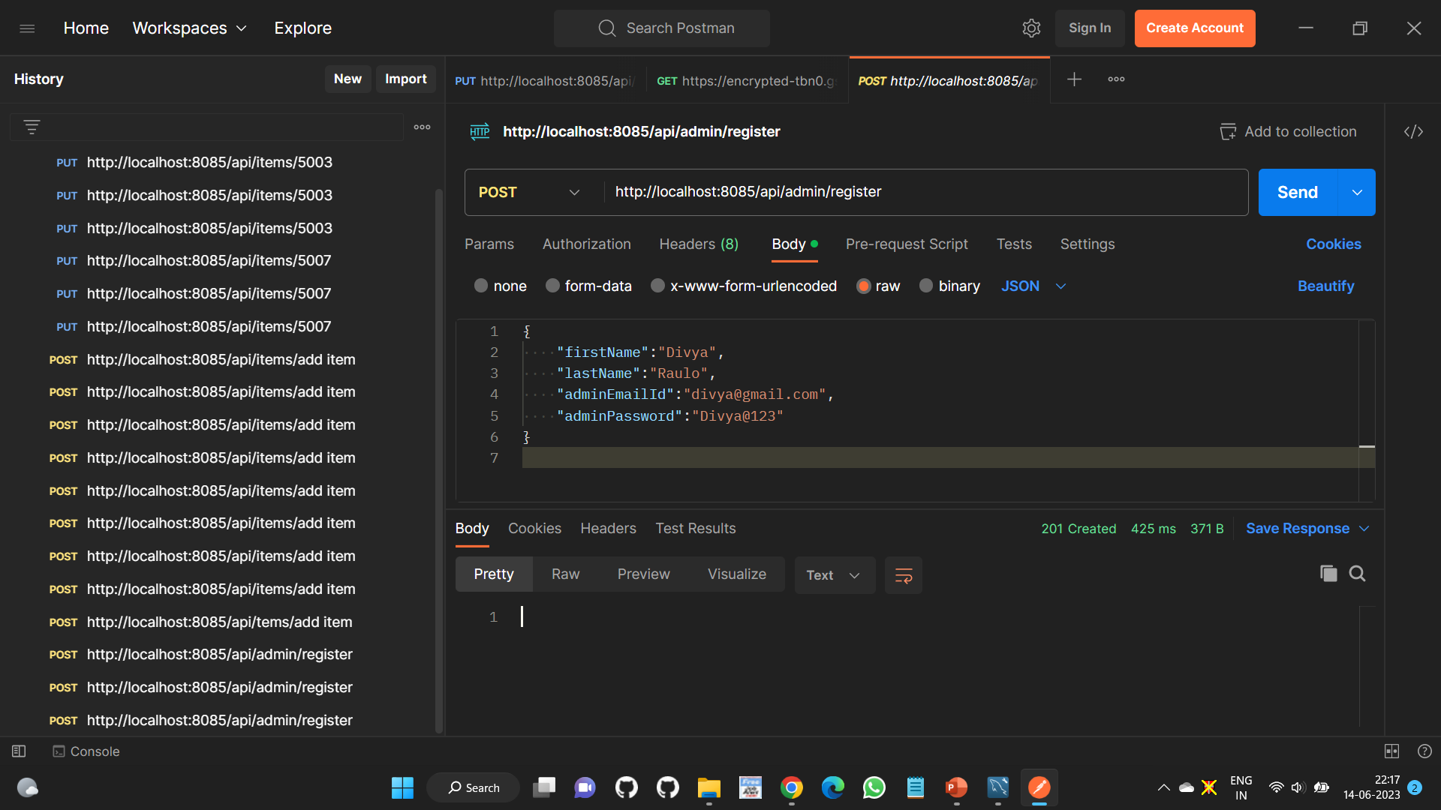
ADMIN REGISTRATION FROM POSTMAN

Slide 14
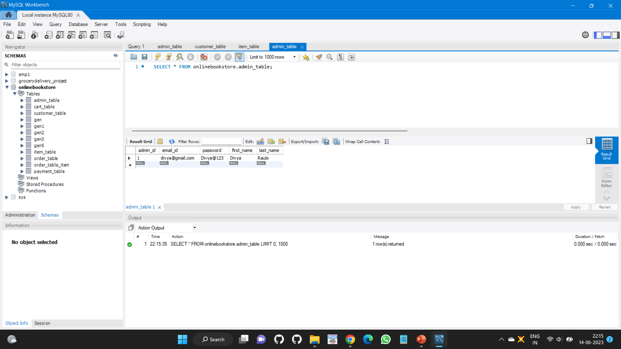
ADMIN TABLE

Slide 15
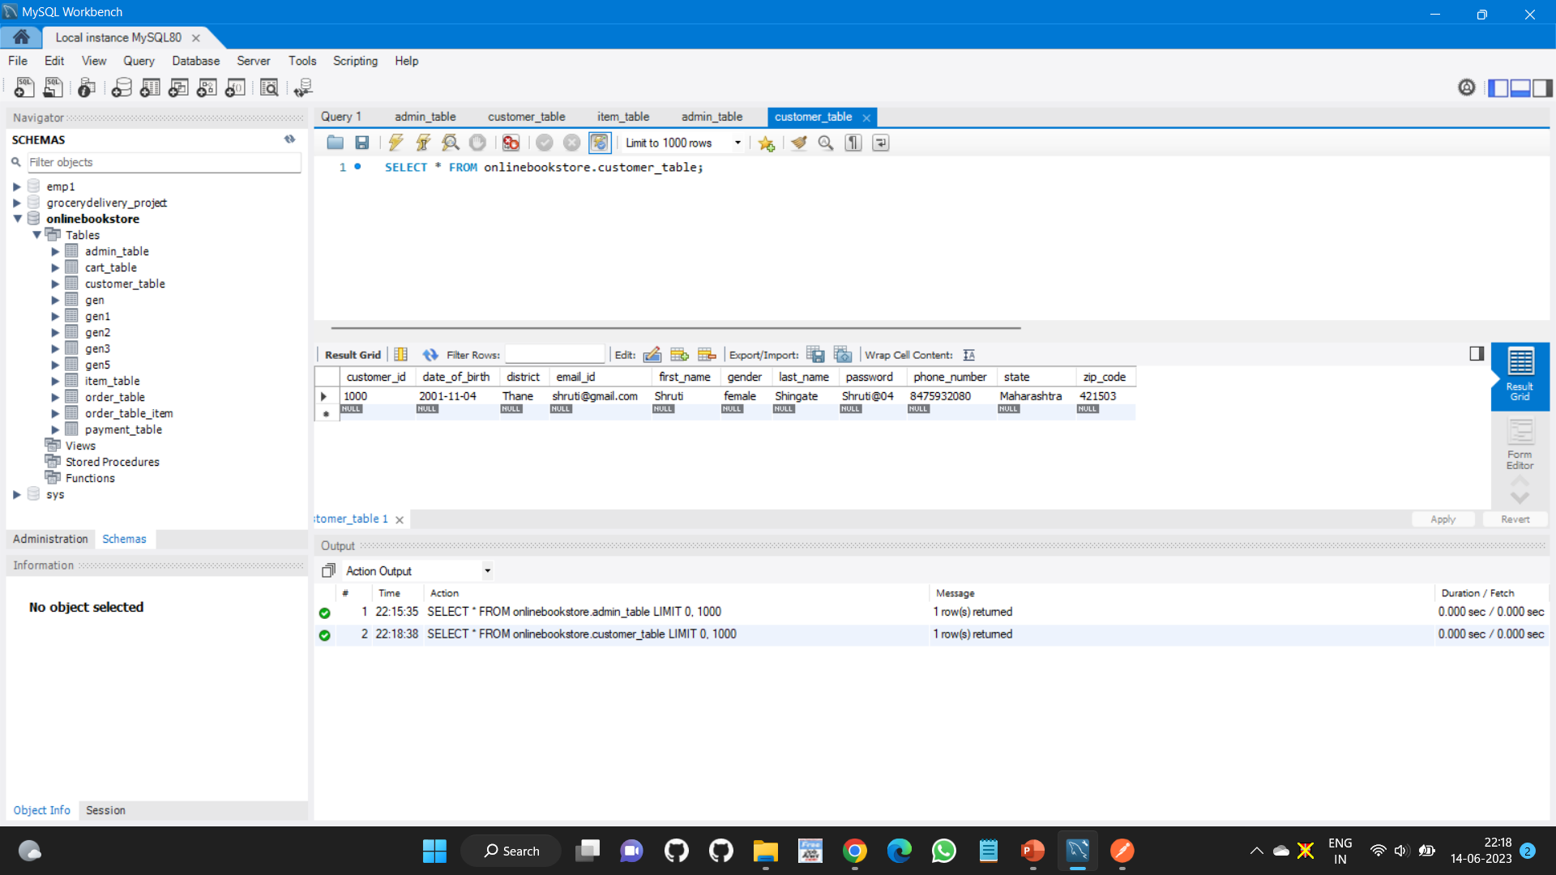
CUSTOMER TABLE

Slide 16
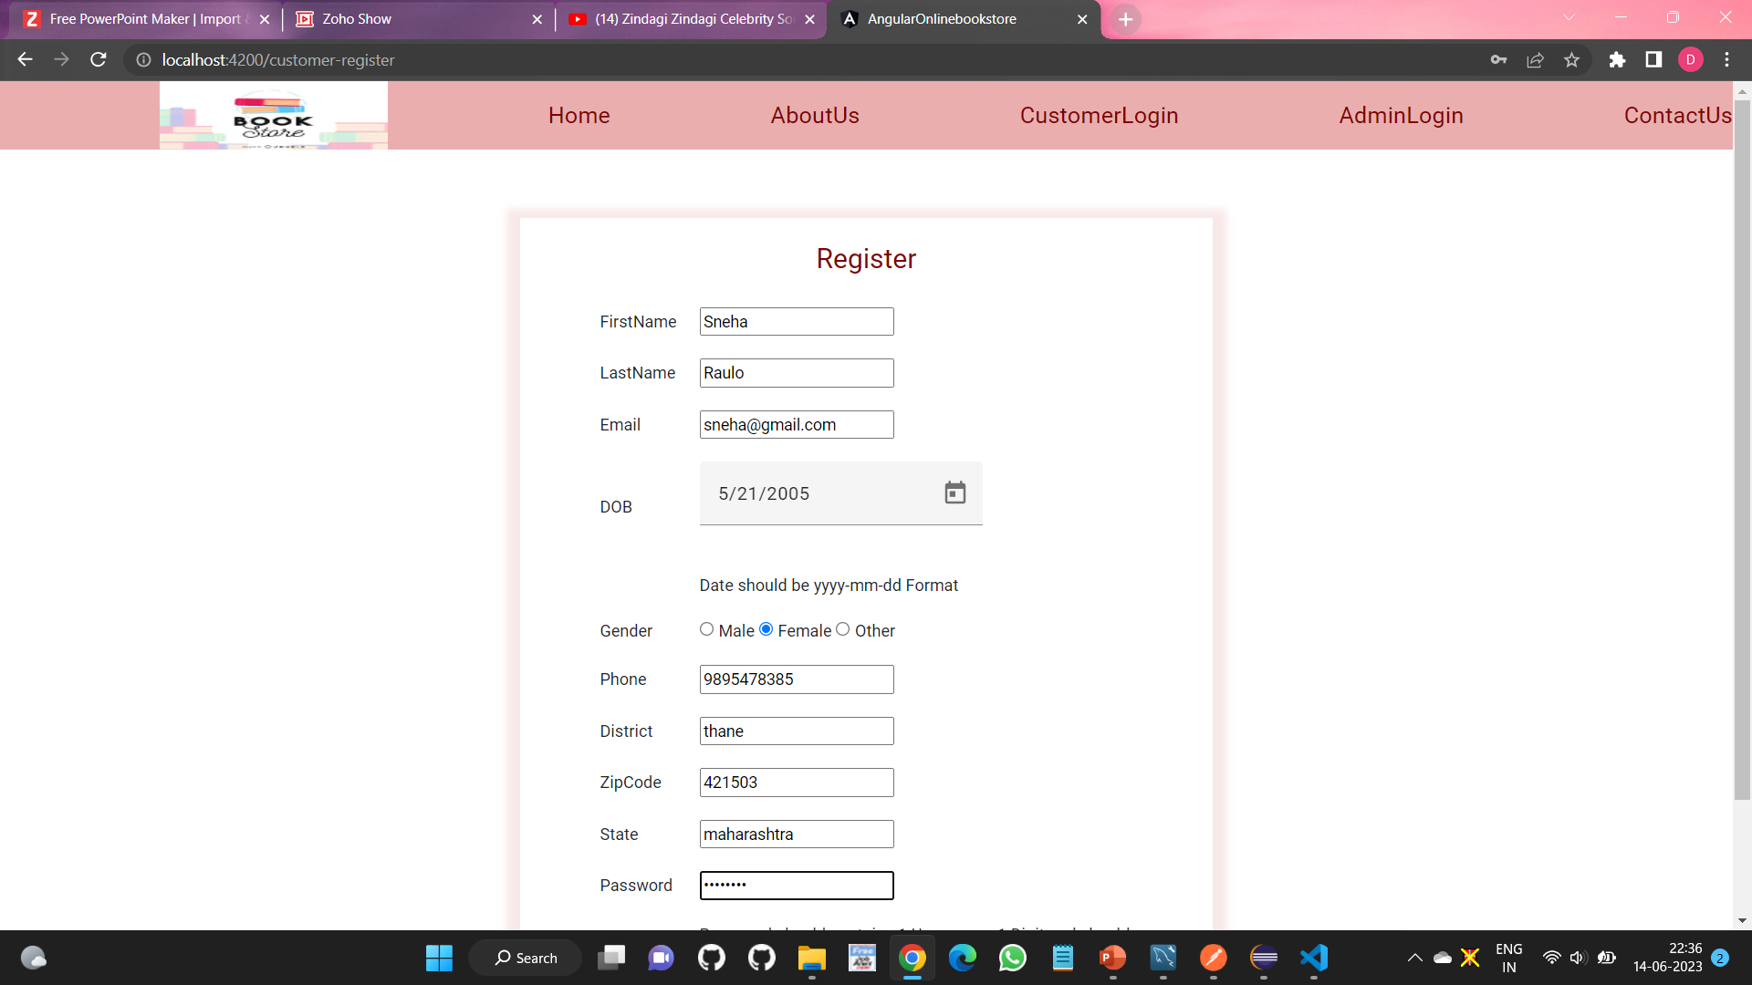
CUSTOMER REGISTRATION

Slide 17
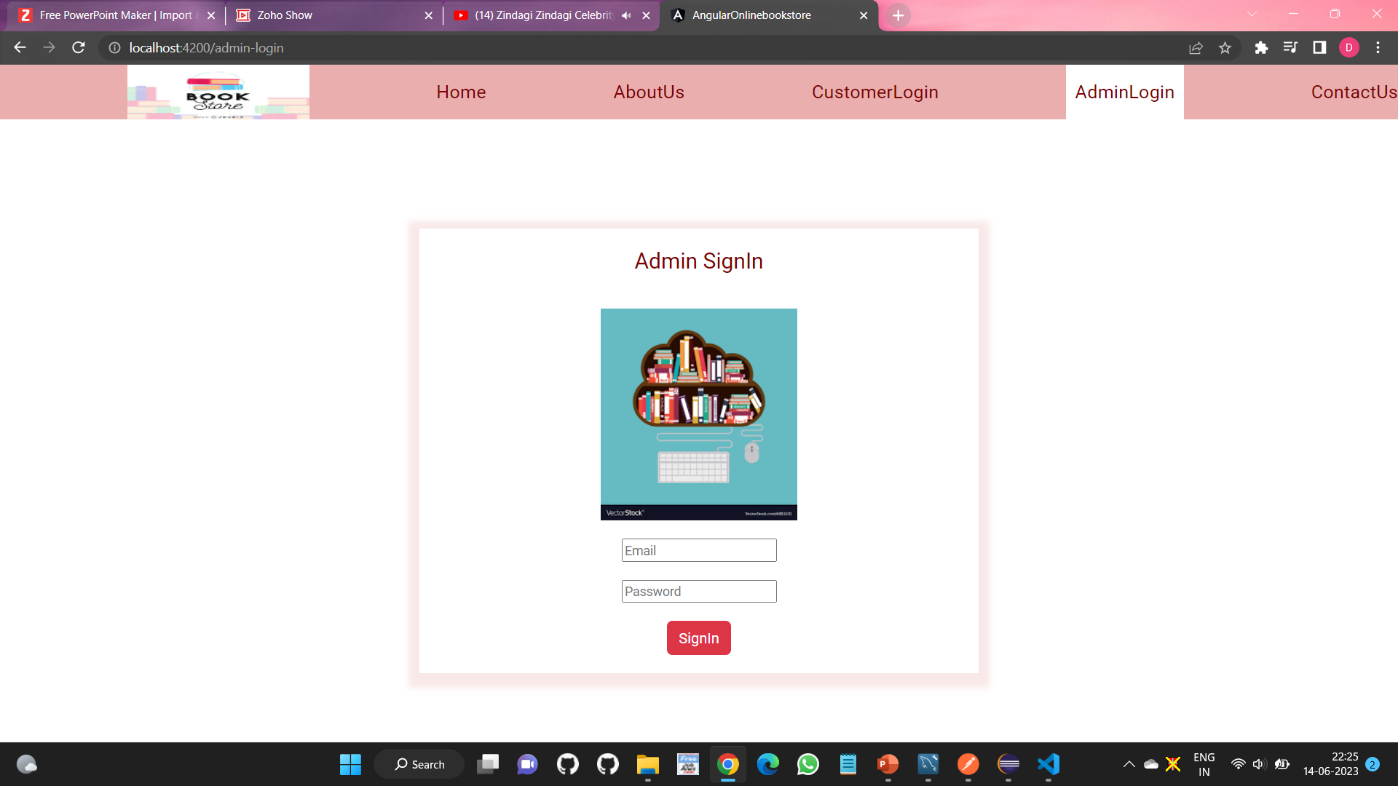
ADMIN LOGIN

Slide 18
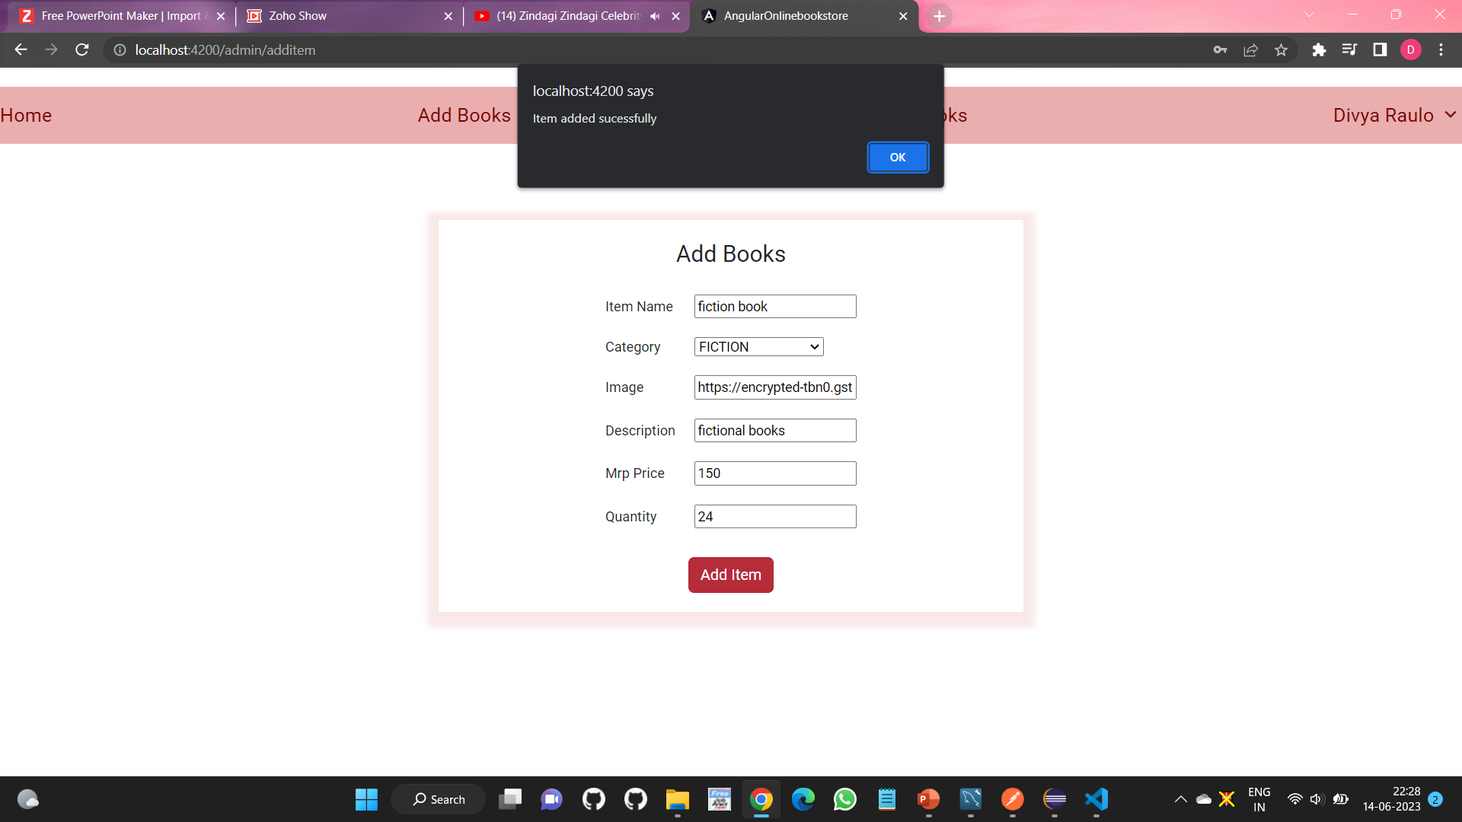
ADD BOOK FROM ADMIN

Slide 19
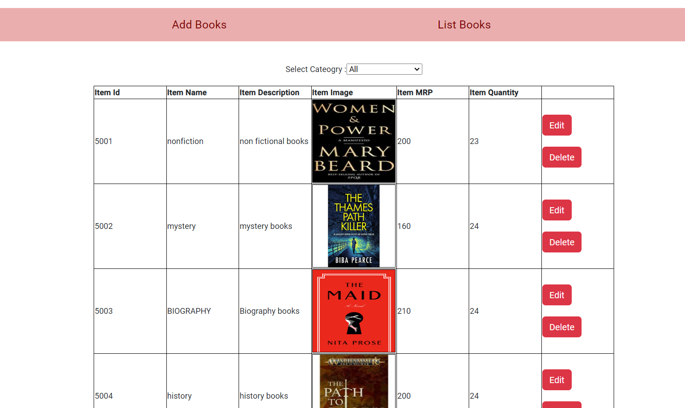
BOOK TABLE

Slide 20
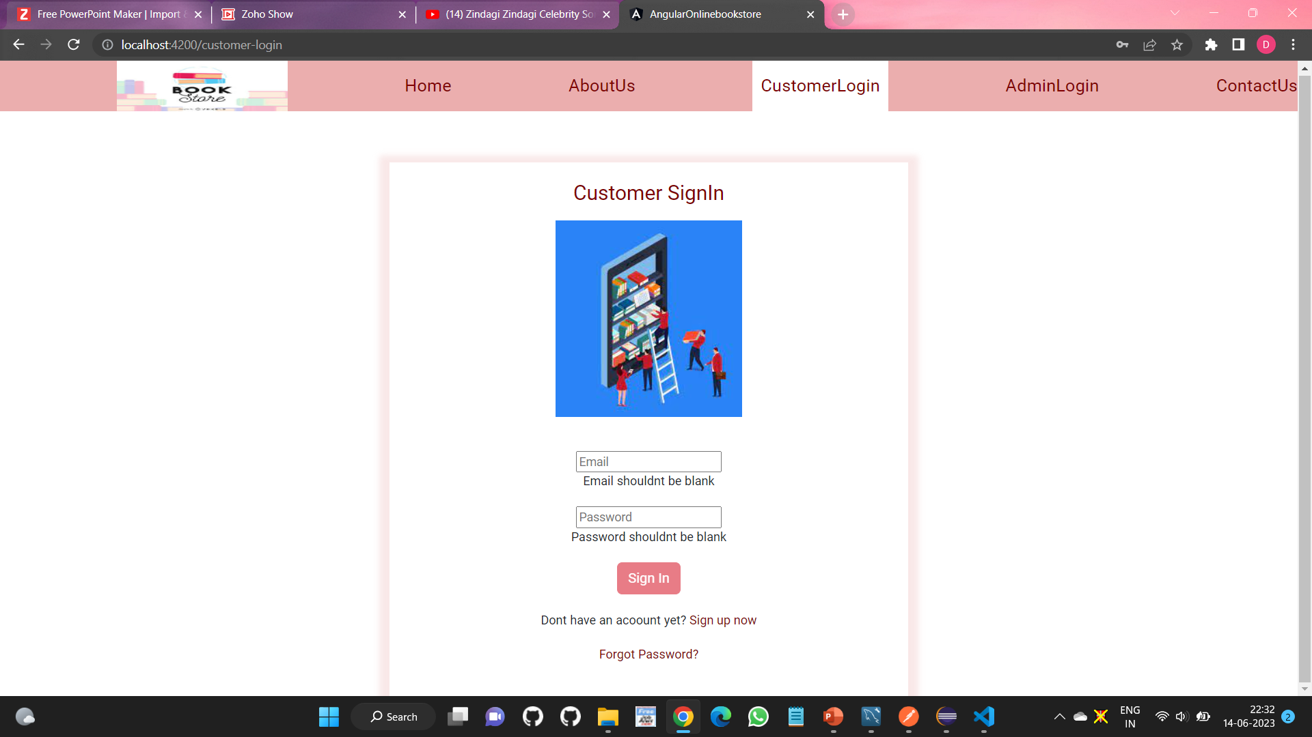
CUSTOMER LOGIN

Slide 21
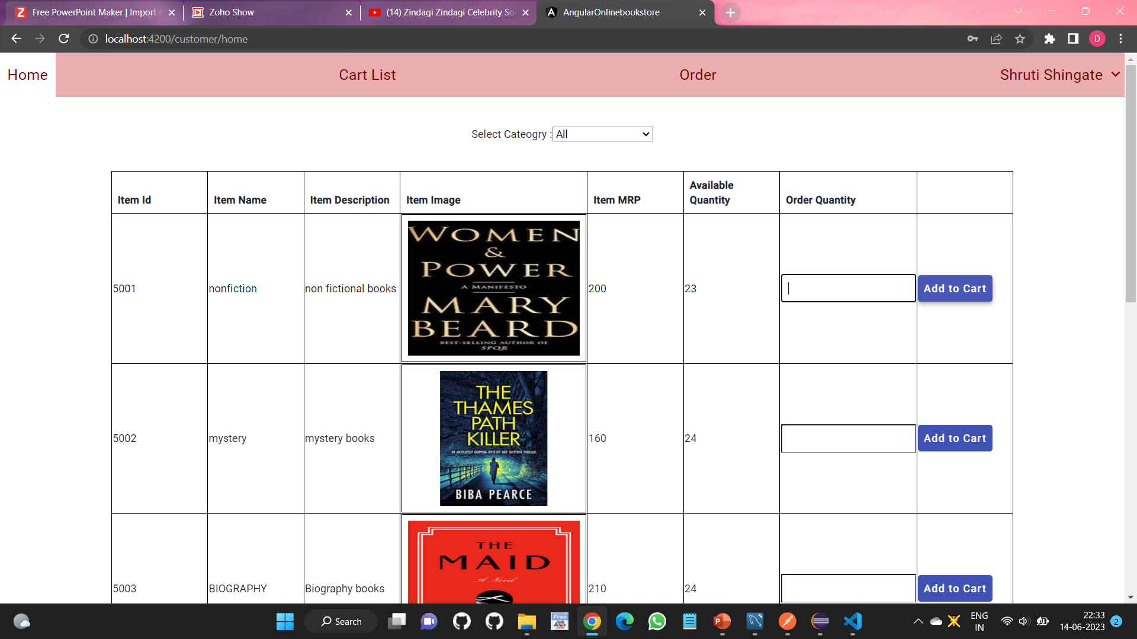
CUSTOMER HOME PAGE

Slide 22
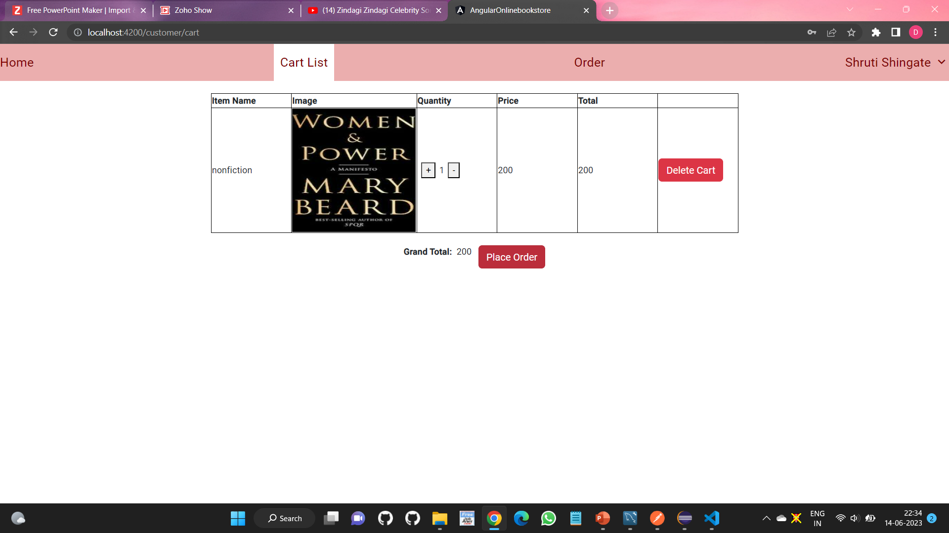
CUSTOMER CART

Slide 23
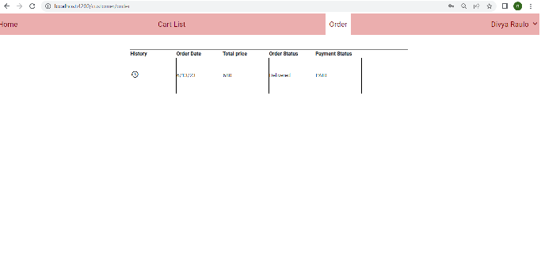
CUSTOMER ORDER

Slide 24
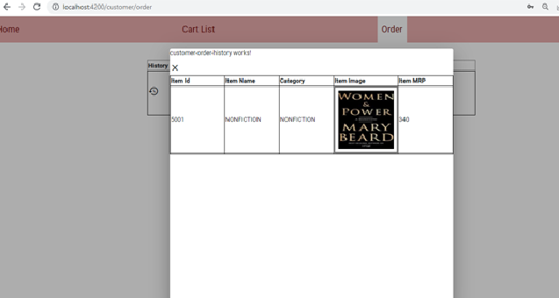
CUSTOMER PAYMENT

Slide 25
ADVANTAGES
Customer can read the book anytime.
Makes the ordering process easier.
Customer's satisfaction.
No need to visit the book store or library.
Discover New Items.

Slide 26
CONCLUSION
Hence, we made the website of online book store which provides more accessibility to admin and simple, attractive interface to user.
It is important to student in this pandemic situation all students can get the books by online which concludes safe delivery of product and student can get the books whenever it needed.

Slide 27
Thank You

